Slide 1
Design and Analysis of Algorithms
CS345
Lecture 6
Stable Matching Algorithm and Applications

Slide 2
Recap from the last Lecture

Slide 3
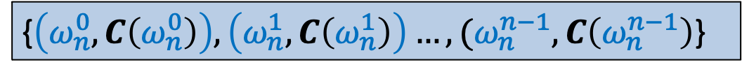

Interpolation
There is a polynomial
$$C\left(x\right)=c_{0}+c_{1}x+c_{2}x^{2}+ …c_{n−1}x^{n−1}$$
with $c_{j}$’s unknown.
Given: the following (point, value) representation of $C\left(x\right)$:
Aim: To compute $c_{j}$’s .
{$\left(ω_{n}^{0}, C\left(ω_{n}^{0}\right)\right),\left(ω_{n}^{1}, C\left(ω_{n}^{1}\right)\right)…,(ω_{n}^{n−1}, C\left(ω_{n}^{n−1}\right)$}

Slide 4
Interpolation
Polynomial Interpolation = Polynomial evaluation
Can you guess the polynomial whose evaluation will help solve polynomial interpolation ?
Make an obvious guess.

Slide 5
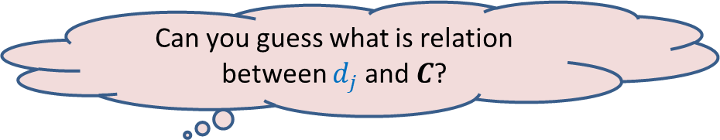

Interpolation
Solution:
Define a polynomial
$D\left(x\right)=d_{0}+d_{1}x+ …+d_{j}x^{j}+ …d_{n−1}x^{n−1}$, where $d_{j}=$ $C\left(ω_{n}^{j}\right)$.
Evaluate $D$ on $R_{n}$.
What is $D\left(ω_{n}^{ℓ}\right)$ ?
Can you guess what is relation between $d_{j}$and $C$?
Homework:

Slide 6
It was very disheartening to see that only a handful of students attempted the homework.
Please attempt each homework sincerely. It is for your own benefit.
If you are not able to do the homework, you may send email to the instructor 1 day in advance for a short meeting (avoid holidays and week-ends).

Slide 7

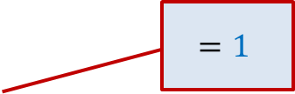

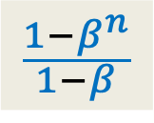


A Tool
$$\{1, ω_{n} ,ω_{n}^{2},ω_{n}^{3},…,ω_{n}^{n−1}\}$$
Question : = ?
If $β=1$,
Otherwise
$$β∈$$
$$=1$$
$$n$$
$$\sum_{0≤j<n}{{\left(β\right)}^{j} }$$
0
$$\frac{1−β^{n}}{1−β}$$

Slide 8

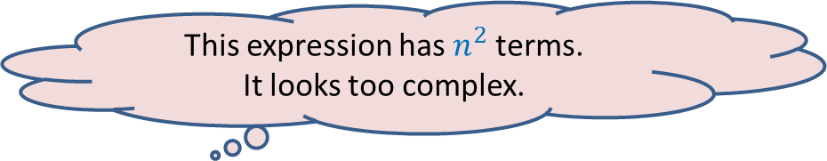

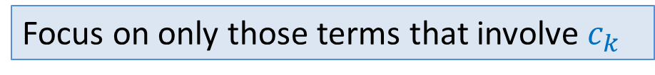
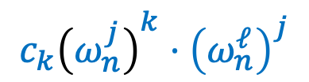

Interpolation
Solution:
Define a polynomial
$D\left(ω_{n}^{ℓ}\right)=d_{0}+d_{1}⋅ω_{n}^{ℓ}+ …+d_{j}⋅{\left(ω_{n}^{ℓ}\right)}^{j}+ …d_{n−1}⋅{(ω_{n}^{ℓ})}^{n−1}$
$$\sum_{0≤t<n}{c_{t}{\left(ω_{n}^{j}\right)}^{t}}$$
$$C\left(ω_{n}^{j}\right)$$
Focus on only those terms that involve $c_{k}$
$${c_{k}\left(ω_{n}^{j}\right)}^{k}⋅{\left(ω_{n}^{ℓ}\right)}^{j}$$
This expression has $n^{2}$terms.
It looks too complex.

Slide 9






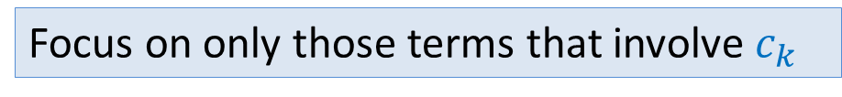









Interpolation
Solution:
Define a polynomial
$D\left(ω_{n}^{ℓ}\right)=d_{0}+d_{1}⋅ω_{n}^{ℓ}+ …+d_{j}⋅{\left(ω_{n}^{ℓ}\right)}^{j}+ …d_{n−1}⋅{(ω_{n}^{ℓ})}^{n−1}$
$$\sum_{0≤t<n}{c_{t}{\left(ω_{n}^{0}\right)}^{t}}$$
$$\sum_{0≤t<n}{c_{t}{\left(ω_{n}^{1}\right)}^{t}}$$
$$\sum_{0≤t<n}{c_{t}{\left(ω_{n}^{j}\right)}^{t}}$$
$$\sum_{0≤t<n}{c_{t}{\left(ω_{n}^{n−1}\right)}^{t}}$$
Focus on only those terms that involve $c_{k}$
$$c_{k}$$
$$c_{k}ω_{n}^{k+ℓ}$$
$${c_{k}\left(ω_{n}^{k+ℓ}\right)}^{j}$$
$${c_{k}\left(ω_{n}^{k+ℓ}\right)}^{n−1}$$
Tool
$$+$$
$$+…+$$
$$+…+$$
$=nc_{k}$
for $k=n−ℓ$
$$=0$$
for $k≠n−ℓ$

Slide 10
Optional Programming Assignment
Implement the algorithm.

Slide 11
Real challenge of multiple merit lists

Slide 12

Fairness
Choice list of Mohan
p
q
p
Mohan
q
Ram
Merit list
of programme q
Ram
Mohan

Slide 13
How to tackle Multiple Merit Lists using “Single Merit list algorithm”

Slide 14

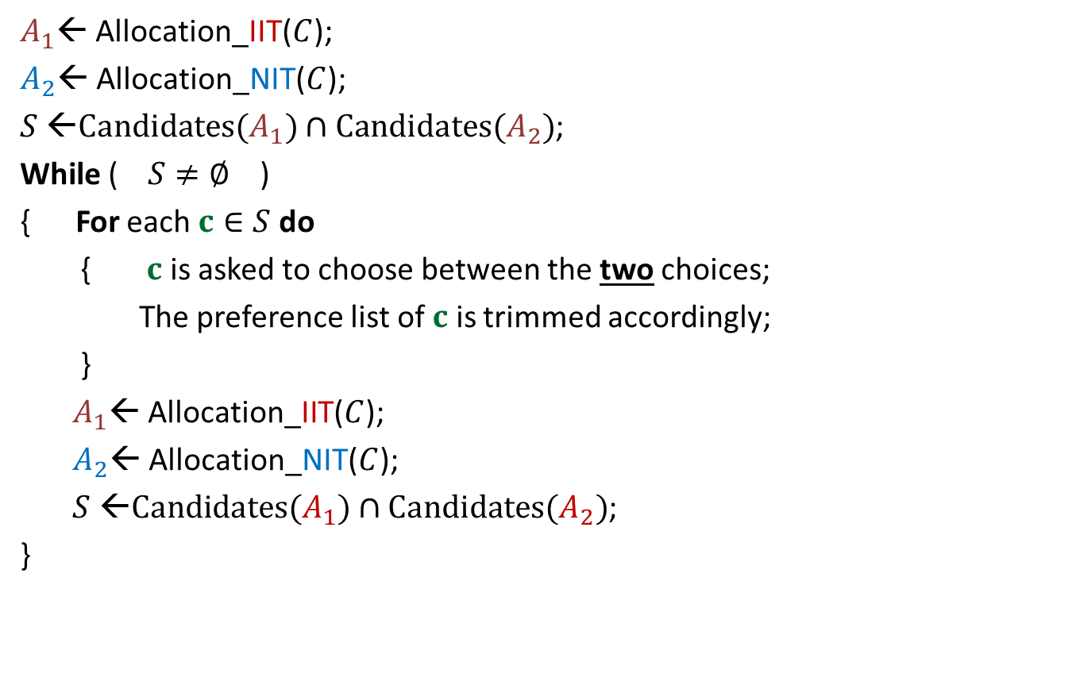


A common man’s algorithm
$A_{1}$← Allocation_IIT($C$);
$A_{2}$← Allocation_NIT($C$);
$S$ ←$Candidates(A_{1})∩Candidates(A_{2})$;
While ( $S≠∅$ )
{ For each $c∈S$ do
{ $c$ is asked to choose between the two choices;
The preference list of $c$ is trimmed accordingly;
}
$A_{1}$← Allocation_IIT($C$);
$A_{2}$← Allocation_NIT($C$);
$S$ ←$Candidates(A_{1})∩Candidates(A_{2})$;
}
Round ← $1$
and
Round $≤5$
)
Round ← Round + $1$
Homework (not for exam): Prove that the algorithm outputs a fair seat allocation.

Slide 15
Multiple merit lists
 | $$1$$ | $$2$$ | $$3$$
IIT
NIT
ARCH
 | $$1$$ | $$2$$ | $$3$$
A
B
C
C B A
IIT
ARCH
NIT
A C B
NIT
IIT
ARCH
B A C
ARCH
NIT
IIT
Merit Lists
Choice Lists
A
B
C
Allocation $1$
Allocation $2$
Allocation $3$
IIT
NIT
ARCH
IIT
NIT
ARCH
IIT
NIT
ARCH
C
A
B
A
B
C
B
C
A
Candidate Pessimal
Candidate Optimal

Slide 16
The Stable Marriage Problem

Slide 17






Stable Marriage Problem
Meaning of unstability
$w_{l}$ prefers $m_{j}$ to $m_{k}$
$m_{j}$ prefers $w_{l}$ to $w_{i}$
Definition:
A marriage is said to be stable if there is no unstable pair in the society.
($w_{l}$, $m_{j}$) : an unstable pair
$$w_{l}$$
divorce
$$m_{k}$$
$$w_{i}$$
divorce
$$m_{j}$$

Slide 18

Stable Marriage Problem
$M$ : set of $n$men
$W$ : set of $n$women
For each man $m∈M$,
$L(m)$: a preference list of all women
For each woman $w∈W$,
$L(w)$: a preference list of all men
Aim: To compute a stable marriage.

Slide 19
Algorithm for Stable Marriage
1962, David Gale and Lloyd Shapley
Nobel Prize in Economic Sciences, 2012
Man proposes, God disposes
Woman

Slide 20
We designed an iterative algorithm in the last class based on these rules.
Rule for Men
A man proposes in the decreasing order of preference.
Once rejected by a woman, the man never proposes to her again.
A woman, if single, accepts a proposal.
A woman, if engaged, accepts a proposal from a man if she prefers him to her current partner.
Rule for Women

Slide 21




GaleShapley($M$, $W$)
(Proof of stability)
Consider the pair ($w_{l}$, $m_{j}$)
There is no unstable pair in the marriage.
How to restate it so that we can prove it easily ?
Lemma :
If $m_{j}$ prefers $w_{l}$ to $w_{i}$
➔ $w_{l}$ prefers $m_{k}$ to $m_{j}$.
If $m_{j}$ prefers $w_{i}$to $w_{l}$,
nothing to be done ☺
$$w_{l}$$
$$m_{k}$$
$$w_{i}$$
$$m_{j}$$
The key observation :
Each new engagement gives a woman a better partner (mate).

Slide 22
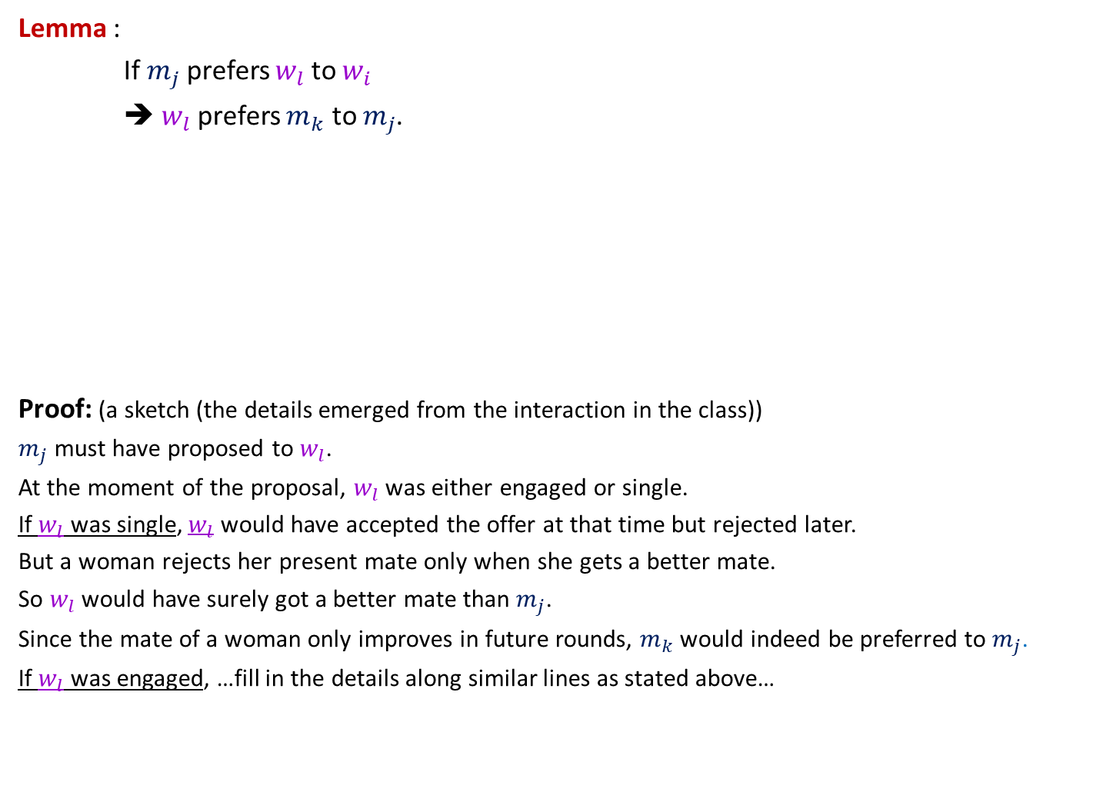
GaleShapley($M$, $W$)
(Proof of stability)
Lemma :
If $m_{j}$ prefers $w_{l}$ to $w_{i}$
➔ $w_{l}$ prefers $m_{k}$ to $m_{j}$.
Proof: (a sketch (the details emerged from the interaction in the class))
$m_{j}$ must have proposed to $w_{l}$.
At the moment of the proposal, $w_{l}$ was either engaged or single.
If $w_{l}$ was single, $w_{l}$ would have accepted the offer at that time but rejected later.
But a woman rejects her present mate only when she gets a better mate.
So $w_{l}$ would have surely got a better mate than $m_{j}$.
Since the mate of a woman only improves in future rounds, $m_{k}$would indeed be preferred to $m_{j}$.
If $w_{l}$ was engaged, …fill in the details along similar lines as stated above…
$$w_{l}$$
$$m_{k}$$
The following slide gives
the steps of the analysis.
$$w_{i}$$
$$m_{j}$$

Slide 23


$$m_{t}$$
$$w_{l}$$
$$m_{k}$$
$$w_{i}$$
$$m_{j}$$
$$m_{p}$$

Slide 24


GaleShapley($M$, $W$)
(Proof of stability)
Lemma : If $m_{j}$ prefers $w_{l}$ to $w_{i}$
➔ $w_{l}$ prefers $m_{k}$ to $m_{j}$.
$$w_{l}$$
$$m_{k}$$
$$w_{i}$$
$$m_{j}$$

Slide 25
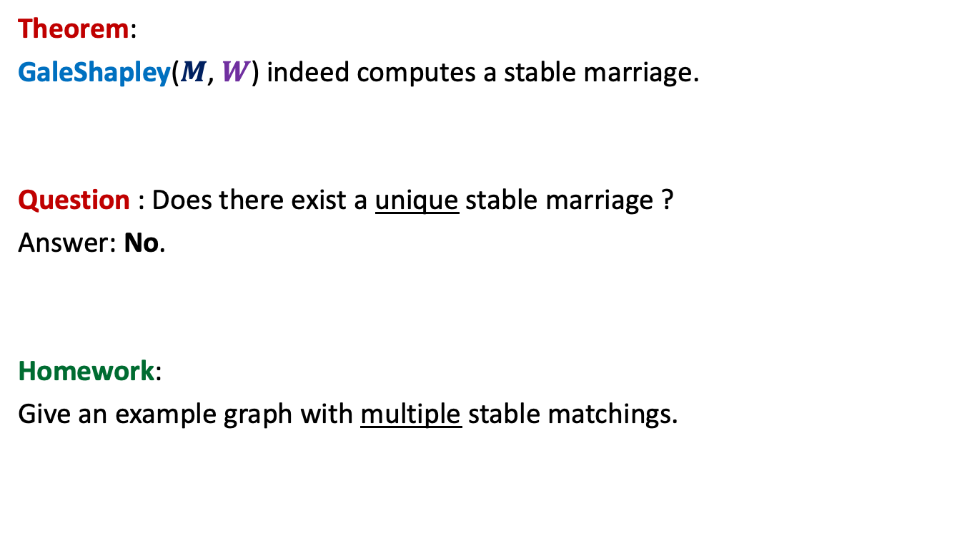

GaleShapley($M$, $W$)
Theorem:
GaleShapley($M$, $W$) indeed computes a stable marriage.
Question : Does there exist a unique stable marriage ?
Answer: No.
Homework:
Give an example graph with multiple stable matchings.

Slide 26


Gale Shapley Algorithm
Theorem:
There cannot exist any other stable matching
that matches a man to a better woman.
Man proposing
Woman pessimal
Man Optimal

Slide 27
Gale Shapley Algorithm
Woman proposing
Woman Optimal
Man Pessimal

Slide 28









Gale Shapley Algorithm
Can you think of using this algorithm to solve the problem of joint seat allocation ?
Women
Men
$$w_{1}$$
$$m_{1}$$
$$w_{2}$$
$$m_{2}$$
$$w_{3}$$
$$m_{3}$$
$$w_{i}$$
$$m_{j}$$
$$w_{n}$$
$$m_{n}$$

Slide 29







Gale Shapley Algorithm
Programs
Men
$$P_{1}$$
$$m_{1}$$
$$P_{2}$$
$$m_{2}$$
$$P_{3}$$
$$m_{3}$$
$$P_{i}$$
$$m_{j}$$
$$P_{n}$$
$$m_{n}$$

Slide 30





Gale Shapley Algorithm
Deferred Acceptance Algorithm
Programs
Candidates
$$P_{1}$$
$$c_{1}$$
$$P_{2}$$
$$c_{2}$$
Preference lists
Unstability
$$P_{3}$$
$$c_{3}$$
Unfairness
Merit lists
$$P_{i}$$
$$c_{j}$$
$$P_{n}$$
$$c_{m}$$

Slide 31
Deferred Acceptance Algorithm
Programs
Candidates
$$P_{1}$$
$$c_{1}$$
$$P_{2}$$
$$c_{2}$$
$$P_{3}$$
$$c_{3}$$
$$P_{i}$$
$$c_{j}$$
$$P_{n}$$
$$c_{m}$$

Slide 32

$3$Algorithms
Gale Shapley
algorithm
Limited rounds
Programme proposing
Programme proposing
Candidate proposing
Common man’s algorithm
Software Industry’s algorithm
Deferred Acceptance algorithm
Candidate Pessimal
Candidate Pessimal
Candidate Optimal

Slide 33
Merits of
Deferred Acceptance Algorithm
Any number of merit lists
Candidate optimality guaranteed
Efficient Algorithm
Joint Seat Allocation
Deferred Acceptance Algorithm

Slide 34
Many complex Business rules of admissions
Affirmative action rules
Freeze/Float/Slide/withdraw
Supernumerary Seats for Female Candidates [’18 - ]
  No increase in male seats
  No adverse affect on chances for the male candidates
  Create supernumerary seats (not reservation at all !)

Slide 35

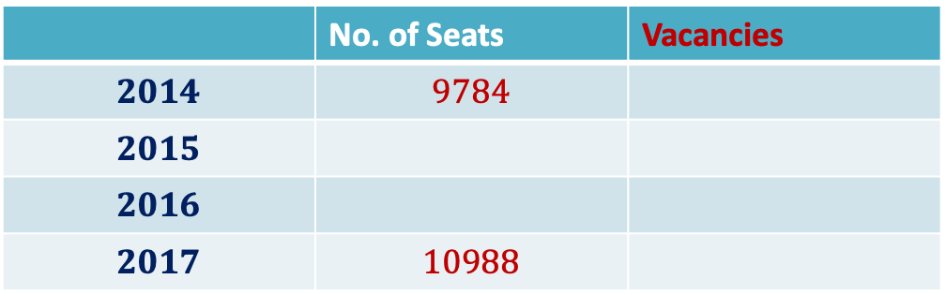



Impact of Joint Seat Allocation
Vacancies in IITs
 | No. of Seats | Vacancies
$$2014$$ | $$9784$$
$$2015$$
$$2016$$
$$2017$$ | $$10988$$
$$587$$
$$308$$
$$190$$
$$198$$

Slide 36

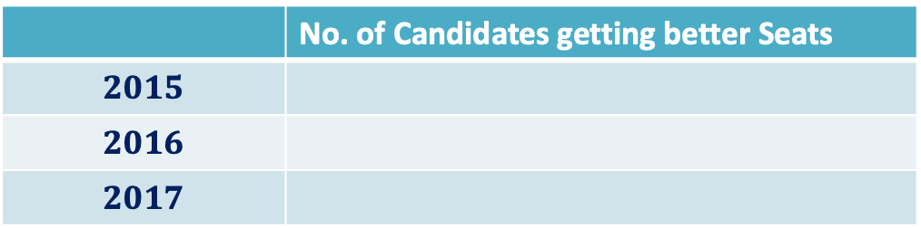



Impact of Joint Seat Allocation
A single vacancy removed ➔
many candidates getting better program (due to cascading effect)
 | No. of Candidates getting better Seats
$$2015$$
$$2016$$
$$2017$$
$$1890$$
$$1767$$
$$1↔300$$
$$3672$$

Slide 37
Algorithms do have great impact in real world …

Slide 38
Impact of Joint Seat Allocation
INFORMS J. Appl. Anal., 49(5) 338-354 (2019)
The above research paper is available on the homepage of the instructor.
Read it to see the role of algorithms in your journey to IITK ☺
Not meant for exam or quizzes ☺
Centralized Admissions for Engineering Colleges in India
S. Baswana, P. P. Chakrabarti, S. Chandran, Y. Kanoria, U. Patange

Slide 39
Gayle Shapley Algorithm
Man-Proposing version
Proof of Man optimality

Slide 40
Gale Shapley Algorithm
Women
Men
$$w_{1}$$
$$m_{1}$$
$$w_{2}$$
$$m_{2}$$
$$w_{3}$$
$$m_{3}$$
$$w_{i}$$
$$m_{j}$$
$$w_{n}$$
$$m_{n}$$

Slide 41
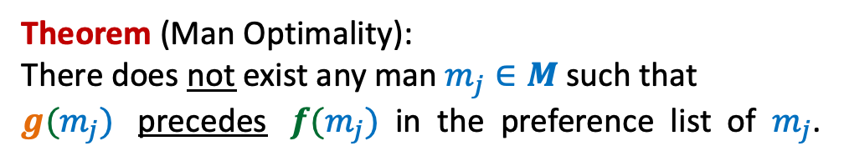

Let $f: M→W$be the matching produced by GS algorithm.
Let $g:M→W$ be any other stable matching.
Theorem (Man Optimality):
There does not exist any man $m_{j}∈M$such that
$g(m_{j})$ precedes $f(m_{j})$ in the preference list of $m_{j}$.

Slide 42
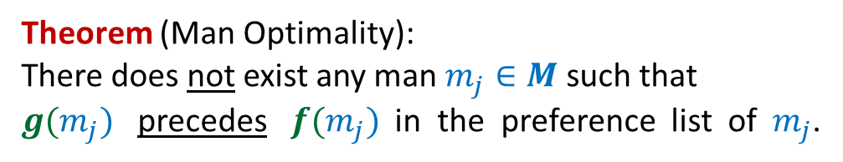

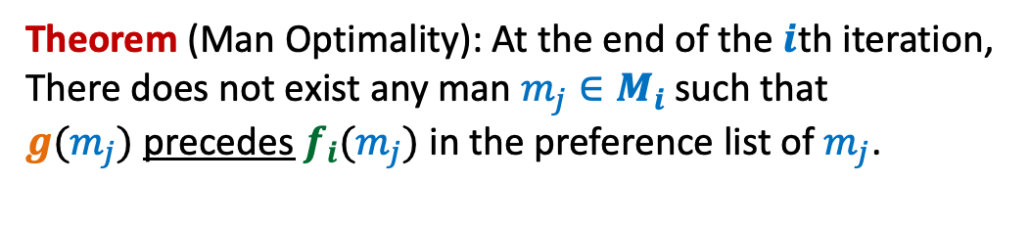
Theorem (Man Optimality):
There does not exist any man $m_{j}∈M$such that
$g(m_{j})$ precedes $f(m_{j})$ in the preference list of $m_{j}$.
At the end of the $i$th iteration,
$M_{i}:$ the set of men matched by GS algorithm.
$f_{i} :M_{i}→W$
Theorem (Man Optimality): At the end of the $i$th iteration,
There does not exist any man $m_{j}∈M_{i}$such that
$g(m_{j})$ precedes $f_{i}(m_{j})$ in the preference list of $m_{j}$.

Slide 43
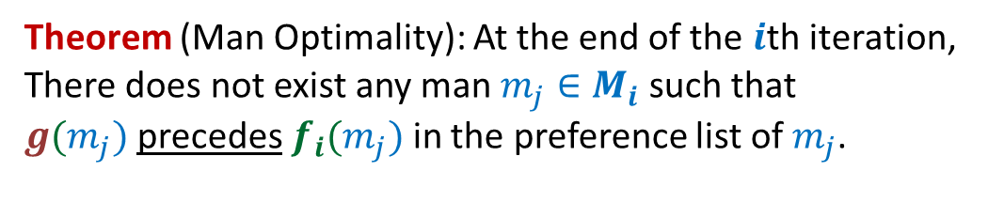


Theorem (Man Optimality): At the end of the $i$th iteration,
There does not exist any man $m_{j}∈M_{i}$such that
$g(m_{j})$ precedes $f_{i}(m_{j})$ in the preference list of $m_{j}$.
$$f_{i}$$
$$g$$

Slide 44

Theorem (Man Optimality): At the end of the $i$th iteration,
There does not exist any man $m_{j}∈M_{i}$such that
$g(m_{j})$ precedes $f_{i}(m_{j})$ in the preference list of $m_{j}$.
1st Iteration
$$f_{1}$$
$$g$$

Slide 45





Theorem (Man Optimality): At the end of the $i$th iteration,
There does not exist any man $m_{j}∈M_{i}$such that
$g(m_{j})$ precedes $f_{i}(m_{j})$ in the preference list of $m_{j}$.
$(i−1)$th iteration:
Execution of $i$th iteration:
$$f_{i−1}$$
$$m_{j}$$
$$g$$

Slide 46


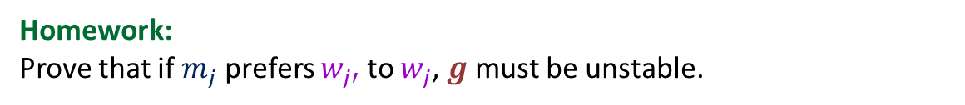

Theorem (Man Optimality): At the end of the $i$th iteration,
There does not exist any man $m_{j}∈M_{i}$such that
$g(m_{j})$ precedes $f_{i}(m_{j})$ in the preference list of $m_{j}$.
Execution of $i$th iteration:
$$w_{j}$$
$$m_{j}$$
$$f_{i}$$
$$w_{j′}$$
$$m_{j}$$
Homework:
Prove that if $m_{j}$ prefers $w_{j′}$ to $w_{j}$, $g$ must be unstable.
$$g$$

